Slide 1
趣味は切手集めです。
A. My hobby is to collect stamps.
B. My hobby is collecting stamps.

Slide 2
動名詞のイメージ
①反復
②中断
③逃避

Slide 3
動名詞のイメージ①：反復
Notes:
Practice, be used to, mind, imagine,
look forward to, ディズニーランド

Slide 4
趣味は切手集めです。
A. My hobby is to collect stamps.
B. My hobby is collecting stamps.

Slide 5
Proverb(ことわざ)
Seeing is believing
Notes:
ことわざ 今も昔も

Slide 6
動名詞のイメージ②：中断
Notes:
Give up, stop, quit, discontinue,

Slide 7
He stopped running.

Slide 8
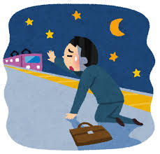
動名詞のイメージ③：逃避
Notes:
Miss, avoid, escape, refuse
Help (I can’t help it)
逃避→反対
Object to –ing, be opposed to
resist

Slide 9
You should avoid easting fried foods.

